Slide 1
Biopharmaceutics &Pharmacokinetics PHT 431
Sources:
Basic Biopharmaceutics &Pharmacokinetics
Prof. Dr. Mohsen Hedaya,
Prof. Dr. Chargel
Internet site: Boomer.com
1

Slide 2
Biopharmaceutics & Pharmacokinetics
Biopharmaceutics:
Is the science that studies the relationship between the physicochemical properties of the drug, the dosage form in which the drug is given and the route of administration and the rate and extent of systemic drug absorption.
Pharmacokinetics is the science of the kinetics of drug Absorption,
Distribution,
Metabolism and
Elimination (kinetic study of ADME).
2

Slide 3

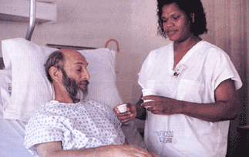

Biopharmaceutics: is the science that deals with the relationship between the drug physicochemical properties, the dosage form characteristics, the route of drug administration and the availability of the drug to the site of drug action.
physicochemical properties
stability, solubility, membrane permeability, and drug affinity to different tissue components.
dosage form characteristics
route of drug administration
availability of the drug to the site of drug action
3

Slide 4
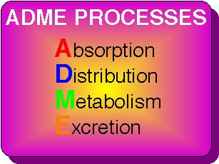
Pharmacokinetics deals with the mathematical description of the rates of drug movement into, within and exit from the body
4

Slide 5
Pharmacodynamics:
Is the time course for the drug effect and the relationship between the drug concentration and the observed therapeutic effects.
Studying the pharmacodynamics of the drug is important in determining the change in the drug effect due to the change of the time course of the drug in the body.
5

Slide 6
Biopharmaceutics
Drug in dosage form
Pharmacodynamics
Release
Drug particles in body fluids
Pharmacologic effect
Dissolution
Degradation
Drug in solution
Peripheral
Tissues
GI
Absorption
Distribution
Liver
Central Compartment
Excretion
Free  Bound
Pharmacokinetics
6

Slide 7
Pharmaco-
- kinetics
(What the body does to the
drug)
Dynamics
(What the drug does to the
body)
7

Slide 8
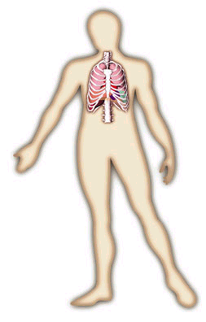
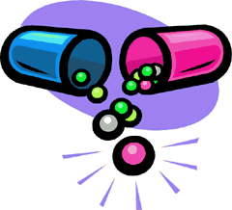
PHARMACODYNAMICS
Site/Mechanism of action, Potency, Efficacy, etc.
PHARMACOKINETICS
Absorption, Distribution, Metabolism, Excretion
8

Slide 9
Pharmacokinetics v. Pharmacodynamics
 | Pharmacokinetics | Pharmacodynamics
Action | Of the body on the drug | Of the drug on the body
System | Absorption, distribution, metabolism, elimination (ADME) | Biological legends or other targets in the biophase.
Output | Concentration-time relationships | Biological response
9

Slide 10
Clinical Pharmacokinetics
Application the basic pharmacokinetic principles in individualization of drug therapy
Drug concentration as a guide for the design of appropriate dosage regimen for each individual patient.
10

Slide 11
The drug-concentration-time profile
A
B
Drug concentration
minimum
effective
concentration
C
Time
Studying the rate of drug absorption, distribution and elimination allows characterization of the time course of the drug concentration in the body.
Administration of the same dose of different drugs to the same individual will produce different drug concentration-time profiles. This is because different drugs have different rate of absorption, distribution and elimination.
11

Slide 12
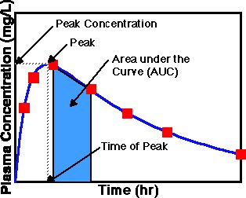
Plasma Concentration Time Curve
Peak plasma concentration (C_{max}) is the maximum concentration or level of the drug reached and it is related to the dose, the absorption rate constant and the elimination rate constant.
Time of peak plasma concentration (t_{max}) is the time of the maximum drug concentration in plasma and it is a measure of the rate of drug absorption.
The area under the curve (AUC) is the area under the plasma concentration time curve which relates to the amount or extent of drug absorbed
12

Slide 13
AUC
Cpn
For example figure 1 shows a curve representing the elimination of a
drug from the plasma after a single intravenous injection.
The area between time intervals is the area of a trapezoid and can be
calculated with the following formula:
=
13

Slide 14
Pharmacokinetic modeling
Compartmental
modeling
Non-Compartmental
modeling
Physiological
modeling
All the designed models are mathematically based
14

Slide 15
Compartment Models
Pharmacokinetic model is defined as a mathematical model used to simulate the rate processes of drug absorption, distribution and metabolism, and predict drug concentration in the body as a function of time.
Pharmacokinetic models are used to predict plasma, tissue and urine drug levels; to estimate the possible accumulation of drugs and also to correlate the drug concentrations with pharmacologic response.
These models are useful to predict the time course of drugs in the body and to allow us to maintain drug concentration in the therapeutic range (optimize therapy).
15

Slide 16
One compartment model
A₁
k
16

Slide 17
Two compartment model
Before distribution
After distribution
A₁
k₁₂
A₂
k₂₁
k
A₁ = central compartment A₂ = peripheral compartment
17

Slide 18
Pharmacokinetic modeling
The goal of pharmacokinetic data analysis
Estimate the pharmacokinetic parameters that determine
the rate of drug absorption, distribution and elimination.
Evaluation of these parameters requires the assumption of
a specific pharmacokinetic model.
Pharmacokinetic models allow quantitative (mathematical)
description of the rate of drug absorption, distribution and
elimination after administration.
18

Slide 19
Why modeling???
1- Prediction of the drug pharmacokinetic behavior after
administration of different dosing regimens.
2- Prediction of the changes in drug pharmacokinetic
behavior due to physiological and pathological changes.
19

Slide 20
Modeling approaches
1- Compartmental modeling:
The body is divided into one or more compartments.
The model describes the distribution of the drug between
the compartments and drug elimination from one or more
of the compartments.
These models differ in the number of compartments and
the arrangement of the compartments relative to each
other.
20

Slide 21
One
compartment
Two
compartments
21
Before distribution
After distribution

Slide 22
Single compartment
D
V
22

Slide 23
A₁
k₁₂
A₂
Two compartment
model
k₂₁
k₁₀
Three compartment
model
k₃₁
k₁₂
A₃
A₁
A₂
k₁₃
k₂₁
k₁₀
23
A₁ = central compartment A_{2 or 3} = peripheral compartments

Slide 24
2- Physiological modeling
The body is divided into a series of organs or tissue
spaces and the model describes the uptake and
disposition of the drug in each of these organs.
Building the model depends on knowledge of the
- Organ size.
- The organ blood flow.
- The drug uptake to each organ.
- Drug elimination from different organs.
24

Slide 25
This modeling technique is very useful
because???
Used to predict the difference in the drug pharmacokinetics
in different species by changing the size, the blood flow,
and the elimination parameters for the different species.
Used to predict the change in drug pharmacokinetics due
to physiological and pathological changes.
25

Slide 26
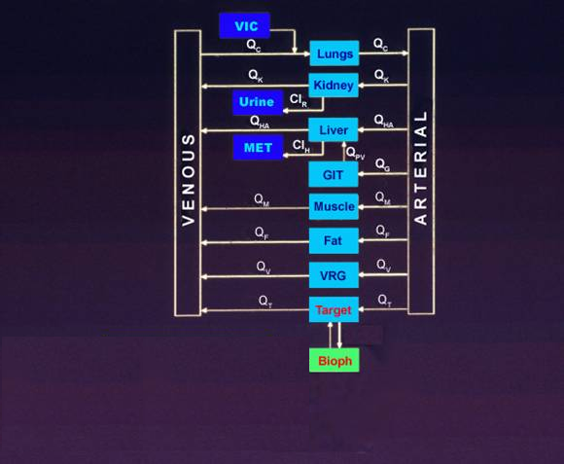
Physiologically Model
26

Slide 27
Model-independent approach:
This approach does not assume any specific model,
but it uses the total body clearance, mean residence
time and volume of distribution to describe the rate of
drug disposition.
27

Slide 28
Mathematical Review
28

Slide 29
Functions
“x” is independent variable
“y” is dependent variable
eg.
29

Slide 30
1) Exponential functions
N = b^{x}
x is the exponent, b is the base, and N represents the number when b is raised to the x^{th} power , ie, b^{x}
eg: 1000 = 10³
Rules of exponents
30

Slide 31
2) Logarithmic function:
N = b^{x}
Then,
eg: 1000 = 10³
Natural logarithm:
Instead of using 10 as a basis for logarithms, a natural base (e) is used.
e = 2.7182818
If, A = e^{n} Then,
Log_{e}(A) = n
ln (A) = n
2.303. log N = ln N
31

Slide 32
Integral Calculus
Integration is the reverse of differentiation and is considered the summation of f(x).dx, the integral sign ∫ implies summation.
Integration Rules:
32

Slide 33
Rules of logarithms
log ab = log a + log b
log a/b = log a - log b
Log 1 = ln 1 = 0
log 1/a = log 1 - log a = - log a
log a² = log a + log a = 2 log a
log a⁻² = -2 log a = 2 log 1/a
log √a =log a^{1/2} = 1/2 log a
ln e^{-x} = -x. ln e = -x
ln e = log_{e}e = 1
33

Slide 34
Differential Calculus
In pharmacokinetics, the amount of the drug in the body is a variable quantity (dependent variable), and time is considered to be an independent variable. Thus we consider the amount of the drug to vary with respect to time.
34

Slide 35
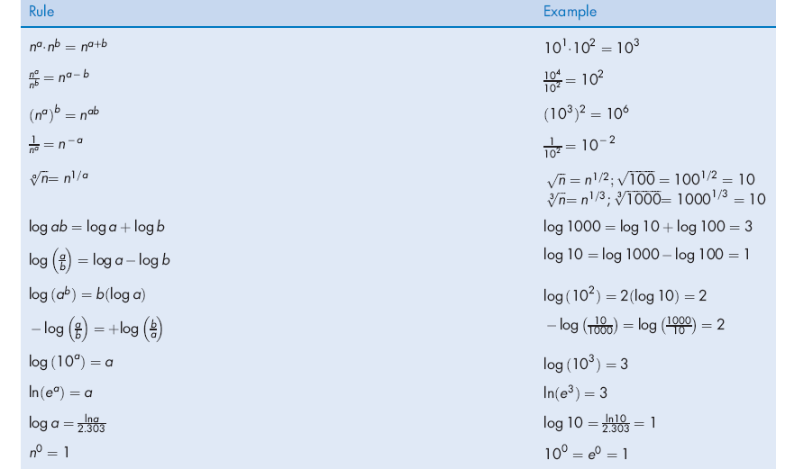
Rules of Differentiation
35

Slide 36
Graphs☺
Language of science is mathematics
and graphs are its pictures.
A graph is simply a visual representation showing how one variable changes with alteration of another variable.
The ‘y’ variable, known as the dependent variable, is represented on the vertical axis (ordinate); and the ‘x’ variable, known as the independent variable, is represented on the horizontal axis (abscissa). It is said that ‘y’ varies with respect to ‘x’ and not ‘x’ varies with ‘y’.
36

Slide 37
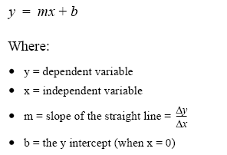
STRAIGHT LINE GRAPHS
37

Slide 38
Linear Regression
Line of best fit
y-axis
Dependant
variable
Slope
y-intercept
Independent
variable
x-axis
Quantitative description of line (trend)
y = m x + b
38

Slide 39

SEMILOGARITHMIC COORDINATES
An expression relating the plasma concentration of a drug (Cp) versus time (t):
This relationship put in linear perspective yields:
Which in the form y = b + mx
39

Slide 40
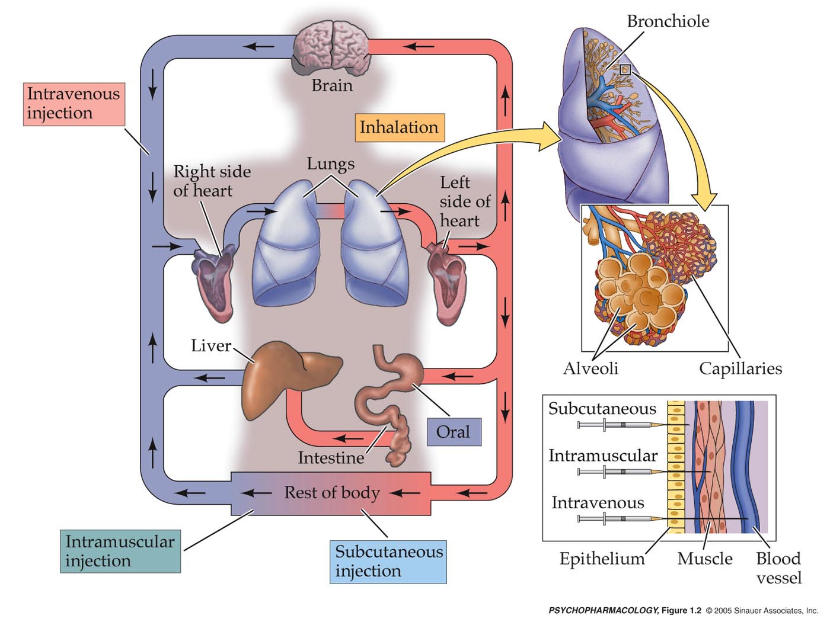
Routes of Administration
40

Slide 41
Anatomic and Physiologic considerations
Lung
Heart
Other tissues
Arterial blood
Kidney
Venous blood
Renal
excretion
L
I
v
e
r
Gut wall
Gut lumen
Metabolism
41
Faecal excretion and decomposition

Slide 42
Definitions
Absorption: Process by which a drug moves from
the site of administration into the site of
action.
Distribution: Reversible transfer of a drug to and
from the site of action.
Elimination: Irreversible transfer of a drug from the
site of action includes metabolic loss
renal excretion, lungs, sweat, milk, etc
42

Slide 43
Application of the biopharmaceutic and pharmacokinetic principles in the biomedical fields
Drug formulation design
Drug dosage form design
Pharmacological testing
Toxicological testing
Evaluation of organ function
Dosage regimen design
43

Slide 44
Linear Pharmacokinetics
Linear = rate of elimination is proportional to amount of drug present.
Dosage increases result in proportional increase in plasma drug levels
Dose or conc.-independent PK
It means all PK parameters are constant, not depend on conc.
Change in the dose lead to change in drug conc.
44

Slide 45
Nonlinear Pharmacokinetics
Nonlinear = rate of elimination is constant regardless of amount of drug present
Dose or conc.-dependent PK
It means PK parameters depend on conc.
Dosage increases saturate binding sites and result in non-proportional ± in drug levels
Then change in the dose does not lead to change in drug conc.
45

Slide 46
Non-linear
kinetics
(e.g. phenytoin)
Linear kinetics
(most drugs)
Rate of eliminat’n
Rate of eliminat’n
Blood drug conc
Blood drug conc
46

Slide 47
Linear and nonlinear pharmacokinetics
Linear Pharmacokinetics | Nonlinear Pharmacokinetics
Dose-independent or concentration-independent pharmacokinetics. The absorption, distribution, and elimination of the drug follow first- order kinetics. All the pharmacokinetic parameters such as the half life, total body clearance and volume of distribution are constant and do not depend on the drug concentration. The change in drug dose results in proportional change in the drug concentration. | Dose-dependent, or concentration-dependent pharmacokinetics. At least one of the pharmacokinetic processes (absorption, distribution or elimination) is saturable. One or more of the pharmacokinetic parameters such as the half life, total body clearance or volume of distribution are concentration- dependent. The change in drug dose results in more than proportional or less than proportional change in drug concentration.
47

Slide 48
Pharmacokinetic simulation
Pharmacokinetic simulations involve graphical presentation of the drug profile (concentration) in the body given specific values for the pharmacokinetic parameters.
For example: The plasma concentration-time profile after a single IV dose administration can be described by the following equation:
The calculated plasma concentrations at the different time points are plotted to show the plasma concentration-time profile. By choosing different values of the pharmacokinetic parameters.
48

Slide 49
Pharmacokinetic simulations can be used to visualize the effect of changing one or more pharmacokinetic parameters on the drug concentration-time profile.
We can change the dose of the drug and keep all the other parameters constant to examine the effect of changing the dose on the drug concentration time profile e.g Vd, CL_{T}
Larger dose produce higher plasma concentrations
49

Slide 50
100
80
Drug at absorption site
1000 mg
60
Plasma drug conc (mg/L)
750 mg
40
20
500 mg
50
Time

